Slide 1
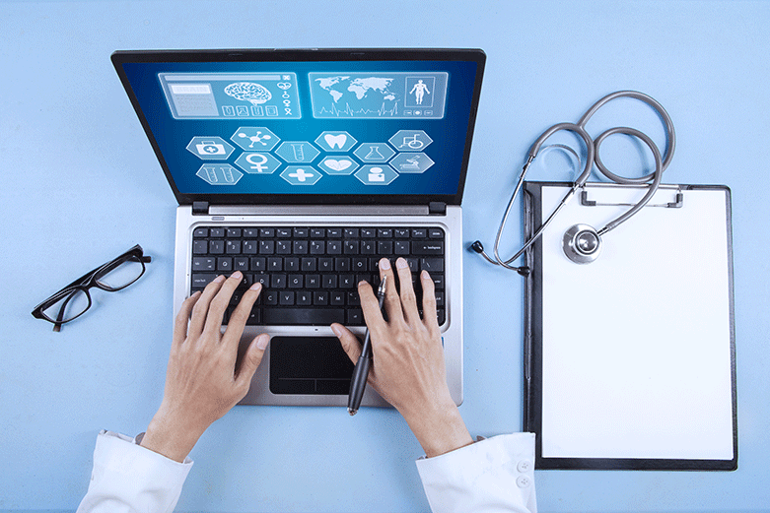


E-Health Care System in Virtual Environment

Slide 2
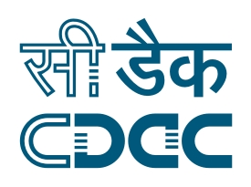
Under Guidance of : Mr. Sangam Kumar Chaturvedi (ICT&S-02) C-DAC, Kolkata
Centre for Development of Advanced Computing, Kolkata
Project Members : Orchid Ganguly (170270620001)
Prithwiraj Dutta (170270620002)
Mohammad Adil (170270620003)
Manish Kumar Gupta (170270620004)

Slide 3
Agenda
Abstract
Introduction
What Is Telemedicine ?
Telemedicine in India
Why Telemedicine is important ?
Technologies Used
Requirement Specification
Modules of E-Healthcare System
Architecture
Design and Block Diagram
Data flow diagram
Implementation
Testing
Conclusion & Future Work
References

Slide 4
Abstract
Implementation of an E-Healthcare System in Virtual Environment is an online system where doctor and patient both can interact to each other. It is observed that distance is a critical barrier for providing medical support in remote areas. This system will help to provide medical support to the people living in the rural areas or a remote location.
The goal is to design a user friendly, responsive and easy to maintain platform with a creative and interactive GUI supported by back-end data for both patient and doctor. The basic functionalities of the system includes Text chat, Video call, Online prescription, Medical document upload etc.
In this project we have used some latest technologies namely HTML, CSS, JSP and servlet for the front end development, MySQL for the backend database part and node.js is used for the video call interface.

Slide 5
Introduction
E-Healthcare System is a web based technology which helps a patient and a doctor to interact with each other from two distant places.
E-Health is a broad term, and refers to the use of information and communications technologies in healthcare.
E-Health covers a lot of territory, which is why digital health industry experts often contest exactly what the term means – and to add to the confusion, it’s also frequently used as a synonym for Health IT.

Slide 6
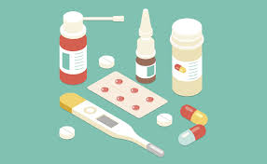
What Is Telemedicine ?
Telemedicine is the use of electronic information to communicate technologies to provide and support healthcare when distance separates the participants. “Tele” is a Greek word meaning “distance “and “mederi” is a Latin word meaning “to heal”. Time magazine called telemedicine “healing by wire”. Although initially considered “futuristic” and “experimental,” telemedicine is today a reality and has come to stay. Telemedicine has a variety of applications in patient care, education, research, administration and public health. Worldwide, people living in rural and emote areas struggle to access timely, good quality specialty medical care. Residents of these areas often have substandard access to specialty healthcare, primarily because specialist physicians are more likely to be located in areas of concentrated urban population. Telemedicine has the potential to bridge this distance and facilitate healthcare in these remote areas.

Slide 7
Why Telemedicine is important?
Telemedicine increases access to healthcare:
Remote patients can more easily obtain clinical services.
Remote hospitals can provide emergency and intensive care services.
Telemedicine improves health outcomes:
Patients diagnosed and treated earlier often have improved outcomes and less costly treatments.
Patients with Telemedicine supported ICU’s have substantially reduced mortality rates, reduced complications, and reduced hospital stays.

Slide 8
(Contd.)…
Telemedicine reduces healthcare costs:
Home monitoring programs can reduce high cost hospital visits.
High cost patient transfers for stroke and other emergencies are reduced.
Telemedicine supports clinical education programs:
Rural clinicians can more easily obtain continuing education.
Rural clinicians can more easily consult with specialists.

Slide 9
Telemedicine in India
In Utopia, every citizen may have immediate access to the appropriate specialist for medical consultation.
In the real world however, this cannot even be a dream. It is a fact of life that “All Men are equal, but
some are more equal than others.” We in India are at present, unable to provide even total primary
medical care in the rural areas. Secondary and tertiary medical care is not uniformly available even in
suburban and urban areas. Incentives to entice specialists to practise even in suburban areas have failed.
In contrast to the bleak scenario in healthcare, computer literacy is developing quickly in India.
Healthcare providers are now looking at Telemedicine as their newly found Avatar. Theoretically, it is far
easier to set up an excellent telecommunication infrastructure in suburban and rural India than to place
hundreds of medical specialists in these places. We have realized that the future of telecommunications
lies in satellite based technology and fibre optic cables.

Slide 10
Technologies Used
HTML5, CSS & Java Script
JSP
Database(MySql)
Servlet
Node.js
WebRTC

Slide 11
Requirement Specification
Hardware Requirements
1. 4 GB RAM,
2. Intel i5 processor,
3. Hard Disk 1 TB,
4. Advance Digital Web Cam,
5. High Definition Audio Speaker.
Software Requirements
1. Java Development Kit(JDK) 1.7,
2. Apache Tomcat 7.0,
3. MySQL server 1.5,
4. Net Beans IDE 8.2,
5. Web Browser.

Slide 12
Modules of E-Healthcare System
User Interface
Controller
Database
Text Chat
Audio-Video Conferencing

Slide 13
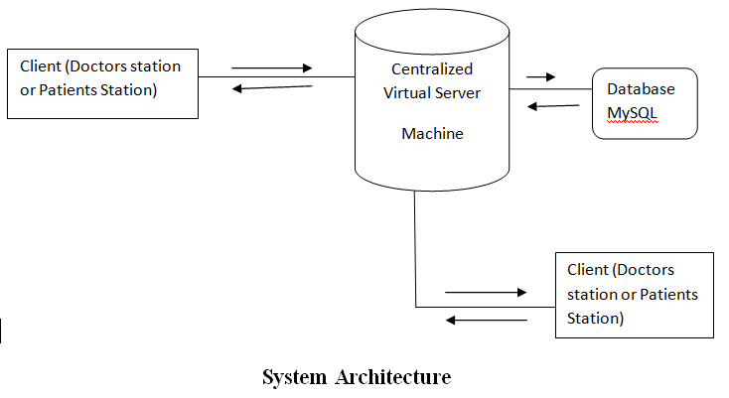
Architecture

Slide 14
Design and Block Diagram
MODEL:
The model part consists of the Back-end Database i.e. MYSQL Engine and classes which perform database oriented tasks. The Model package is used for the database connection set up. It consist of a class called connect which set up the connection between the database and the application.
View:
The view part consists of a number of web pages which are shown to the users. Here in this system the view part includes a number of JSP pages which accepts data or some particular request from the users.

Slide 15
(Contd.)…
Controller:
The controller portion consists of the Servlets which basically works as a middleware between the view and the model. It accepts the request from the user and process it accordingly in order to retrieve the result from the database.
There are also two additional packages are used to implement this MVC model and they are DTO (Database Transfer Object) package and DAO (Database Access Object) package.

Slide 16
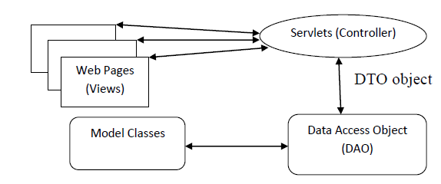
(Contd.)…
Fig: MVC Model

Slide 17
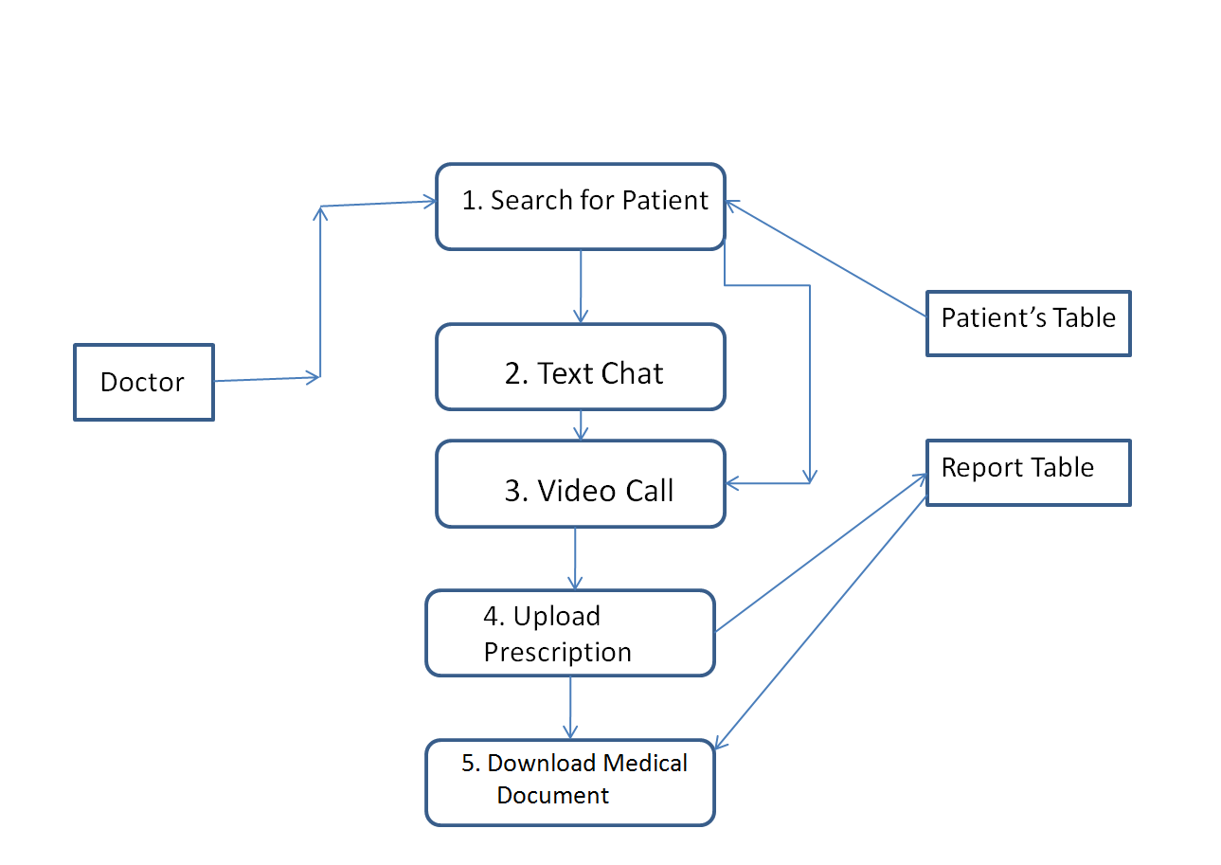
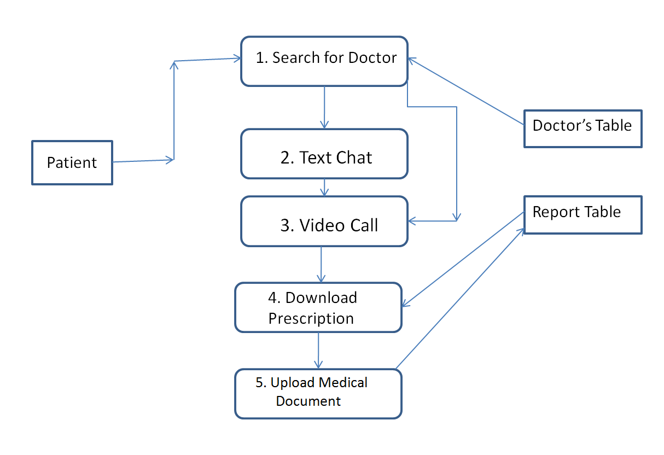
Data flow diagram

Slide 18
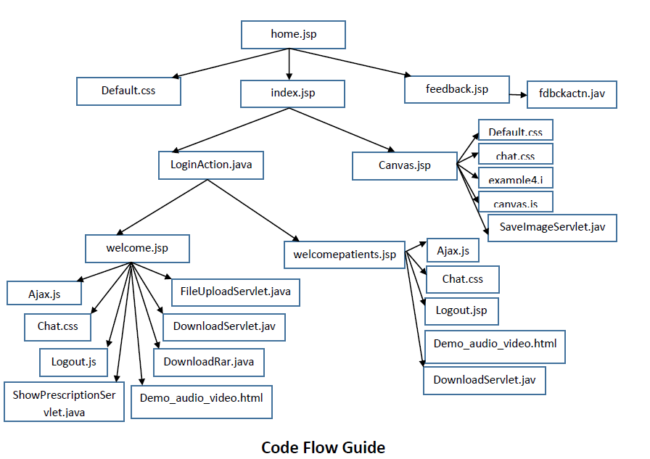
Code Flow

Slide 19
Testing
Module Wise Alpha Testing
Integration Testing
System Testing

Slide 20
Conclusion
The portal E-Health Care System in Virtual Environment reduces the considerable drawbacks like burden of human labour, long awaited appointments and hectic schedule of Doctors. This portal saves time and provides 24 hour accessibility even from a remote place. The portal offers a tremendous option to establish an interaction between doctor and patient through audio-video chat or text chat.
The implemented system provides a simple but effective telemedicine support for patients. The system will ensure a quality treatment for the people living in the rural areas or any remote location. It has been successfully implemented and tested in a similar environment with a few number of people. Due to it’s user responsive and easy to understand GUI, the system is very much user friendly.
The system has to be tested with a large number of patients and doctors in order to test its scalability and performance. The acceptance of the system also needs to be verified.

Slide 21
Future Work
Deploying the system in a cloud.
Making the system more responsive.
Improving each module.
Adding the handwritten prescription module.

Slide 22
References
1. http://www.google.com
2. https://www.w3schools.com/
3. https://www.apachefriends.org/download.html
4. https://webrtc.org/
5. Web based Bangla Online Handwritten Prescription system for Telemedicine through Multimedia Conferencing http://ijarcet.org/wp-content/uploads/IJARCET-VOL-3-ISSUE-12-4128-4133.pdf

Slide 23


